Slide 1


IBM HR Analytics Employee Attrition & Performance
Objective of the Project
Understand Current Turnover Rates: Gain a comprehensive understanding of the current employee turnover rate and analyse the demographic distribution of attrition by age, gender, education, department and job role.
Identify Key Factors Influencing Turnover: Examine the main factors contributing to employee attrition, including job satisfaction indicators (job involvement and work-life balance, salary factors (monthly income and salary hikes), and benefit factors (stock option levels), to uncover patterns and correlations that drive higher attrition rates.

Slide 2
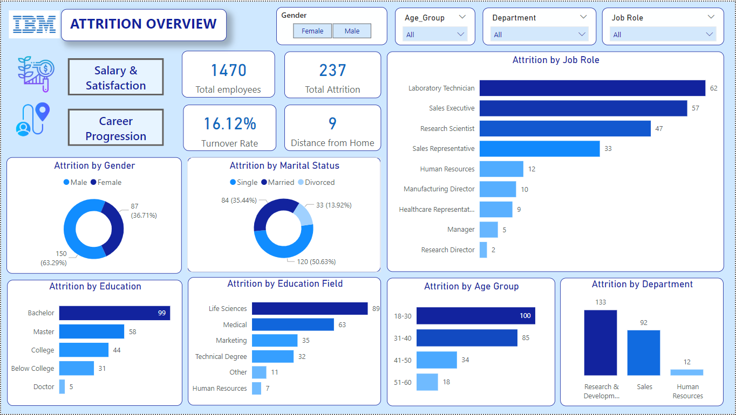
Visualizes demographic and departmental attrition trends to identify high-risk employee segments

Slide 3
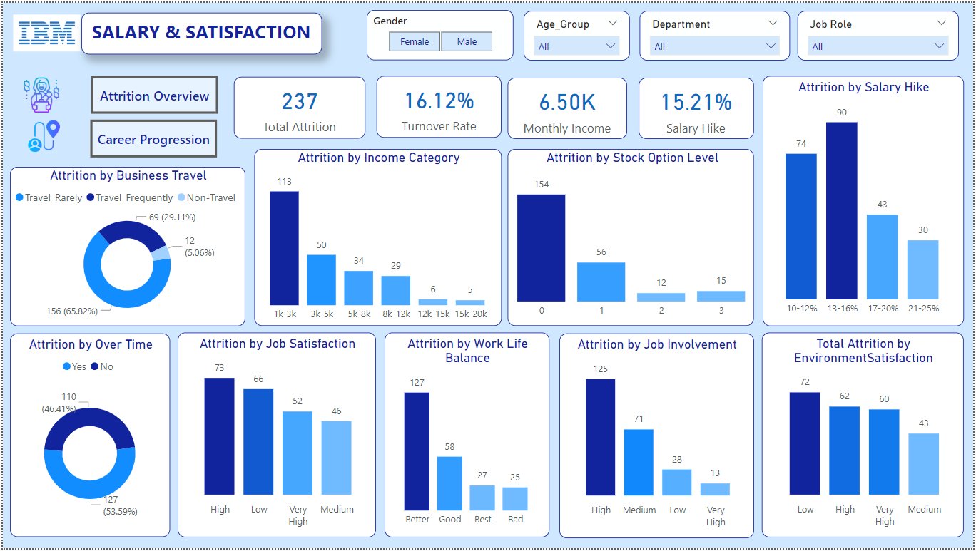
Evaluates the impact of job satisfaction, compensation, and work-life balance on employee turnover

Slide 4
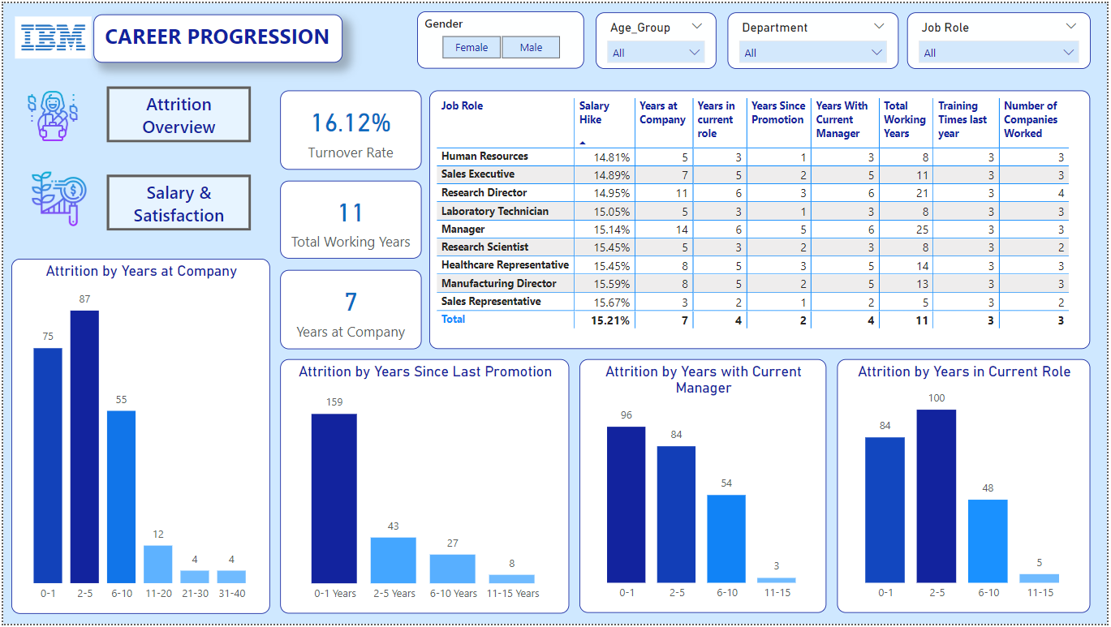
Assesses the role of career growth opportunities and tenure in driving attrition rates

Slide 5
Insights:
Gender: Male employees have a higher attrition rate (63.29%) compared to females.
Marital Status: Single employees (50.63%) exhibit higher attrition than married or divorced ones, indicating potential dissatisfaction among unmarried employees.
Job Roles: Laboratory Technicians and Sales Executives experience the highest attrition, highlighting a potential need to investigate these roles' work conditions or challenges.
Education: Most attrition occurs among employees with a Bachelor's degree, suggesting they may seek higher education or better opportunities.
Education Field: The high attrition rate among employees with a background in Life Sciences reflects potential dissatisfaction or challenges specific to their roles or opportunities within the organization.
Age Group: The majority of attrition is concentrated in the 18-30 age group, possibly reflecting career exploration or dissatisfaction among younger employees.
Departments: Research & Development and Sales departments have the highest turnover rates, calling for targeted interventions in these areas.
Business Travel: Employees who travel rarely show the highest attrition (65.82%), implying potential stress related to infrequent but disruptive travel.
Income Category: Employees earning between 1k-3k monthly experience the highest attrition, indicating dissatisfaction with low wages.

Slide 6
Insights:
Income Category: Employees earning between 1k-3k monthly experience the highest attrition, indicating dissatisfaction with low wages.
Job Satisfaction: Employees with high job satisfaction leave more frequently, reflecting potential lack of growth while it is second highest of low job satisfaction indicating disengagement or workplace dissatisfaction.
Work-Life Balance: High attrition for "better" and "good" work-life balance suggests that while balance is adequate, employees may leave for reasons like career growth, pay, or external opportunities.
Environment Satisfaction: Employees with low satisfaction in their work environment exhibit the highest turnover, pointing to workplace improvements as a key retention strategy.
Stock Option Level: High attrition at stock option level 0 indicates employees may feel undervalued or lack financial incentives to stay, prompting them to seek better benefits elsewhere.
Salary Hike: Moderate salary hikes (13%-16%) are associated with higher attrition, suggesting salary increases alone may not suffice to retain employees.
Years at Company: Most attrition occurs within the first five years, with a significant drop after that, highlighting onboarding and early engagement as critical phases.
Years Since Last Promotion: Employees who have not been promoted within 1-5 years are more likely to leave, underlining the importance of timely career advancement opportunities.
Years with Current Manager: Short tenures with a current manager (0-1 year) have the highest attrition, indicating potential gaps in leadership or alignment.
Current Role Duration: Employees in roles for 0-5 years leave at a higher rate, suggesting a need for role variety and progression.

